Slide 1
RadSee: See Your Handwriting Through Walls Using FMCW Radar
Leonardo Rufini - 2008161
Advanced Information System Security And Blockchain
Sapienza University of Rome

Slide 2
Table of contents
Introduction
Comparison
Challenges & HW
Attack Models
Results

Slide 3
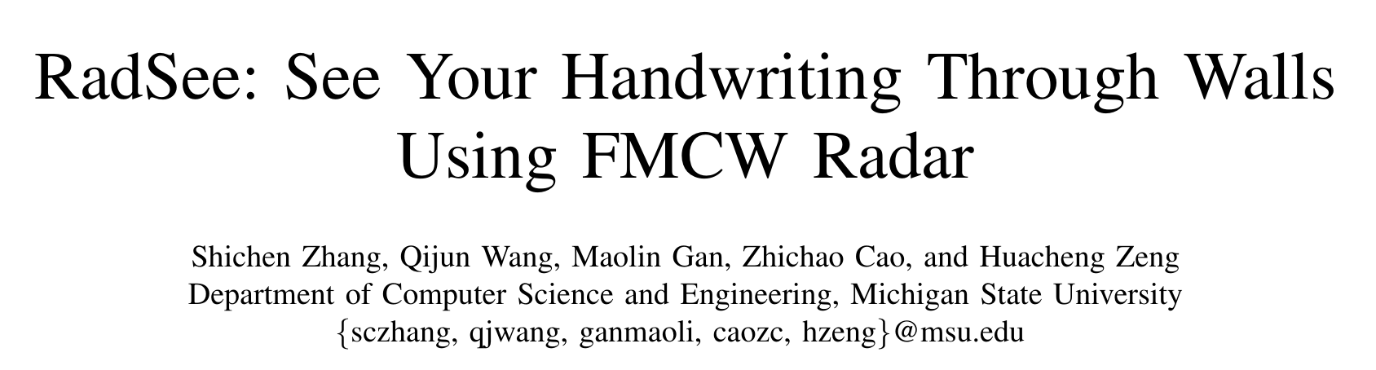
Introduction: The paper
RadSee:See Your Handwriting Through Walls Using FMCW Radar- Leonardo Rufini

Slide 4
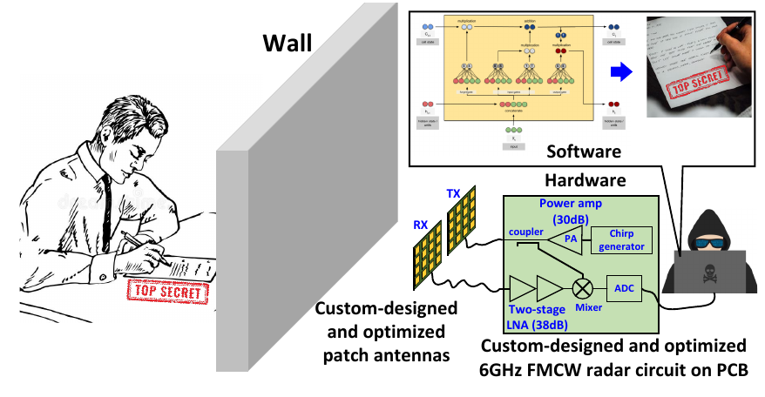
Introduction: Concept
Designing and implementing a radio device capable of detecting a person handwriting through a wall.
RadSee:See Your Handwriting Through Walls Using FMCW Radar- Leonardo Rufini

Slide 5
Other HAR technologies
RadSee:See Your Handwriting Through Walls Using FMCW Radar- Leonardo Rufini

Slide 6

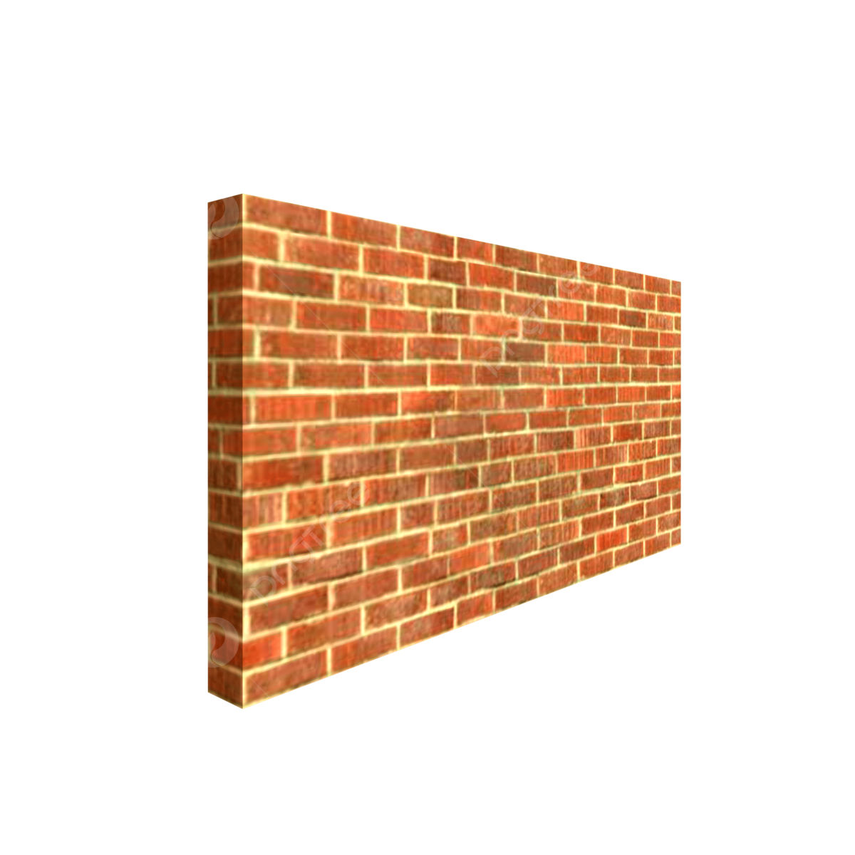

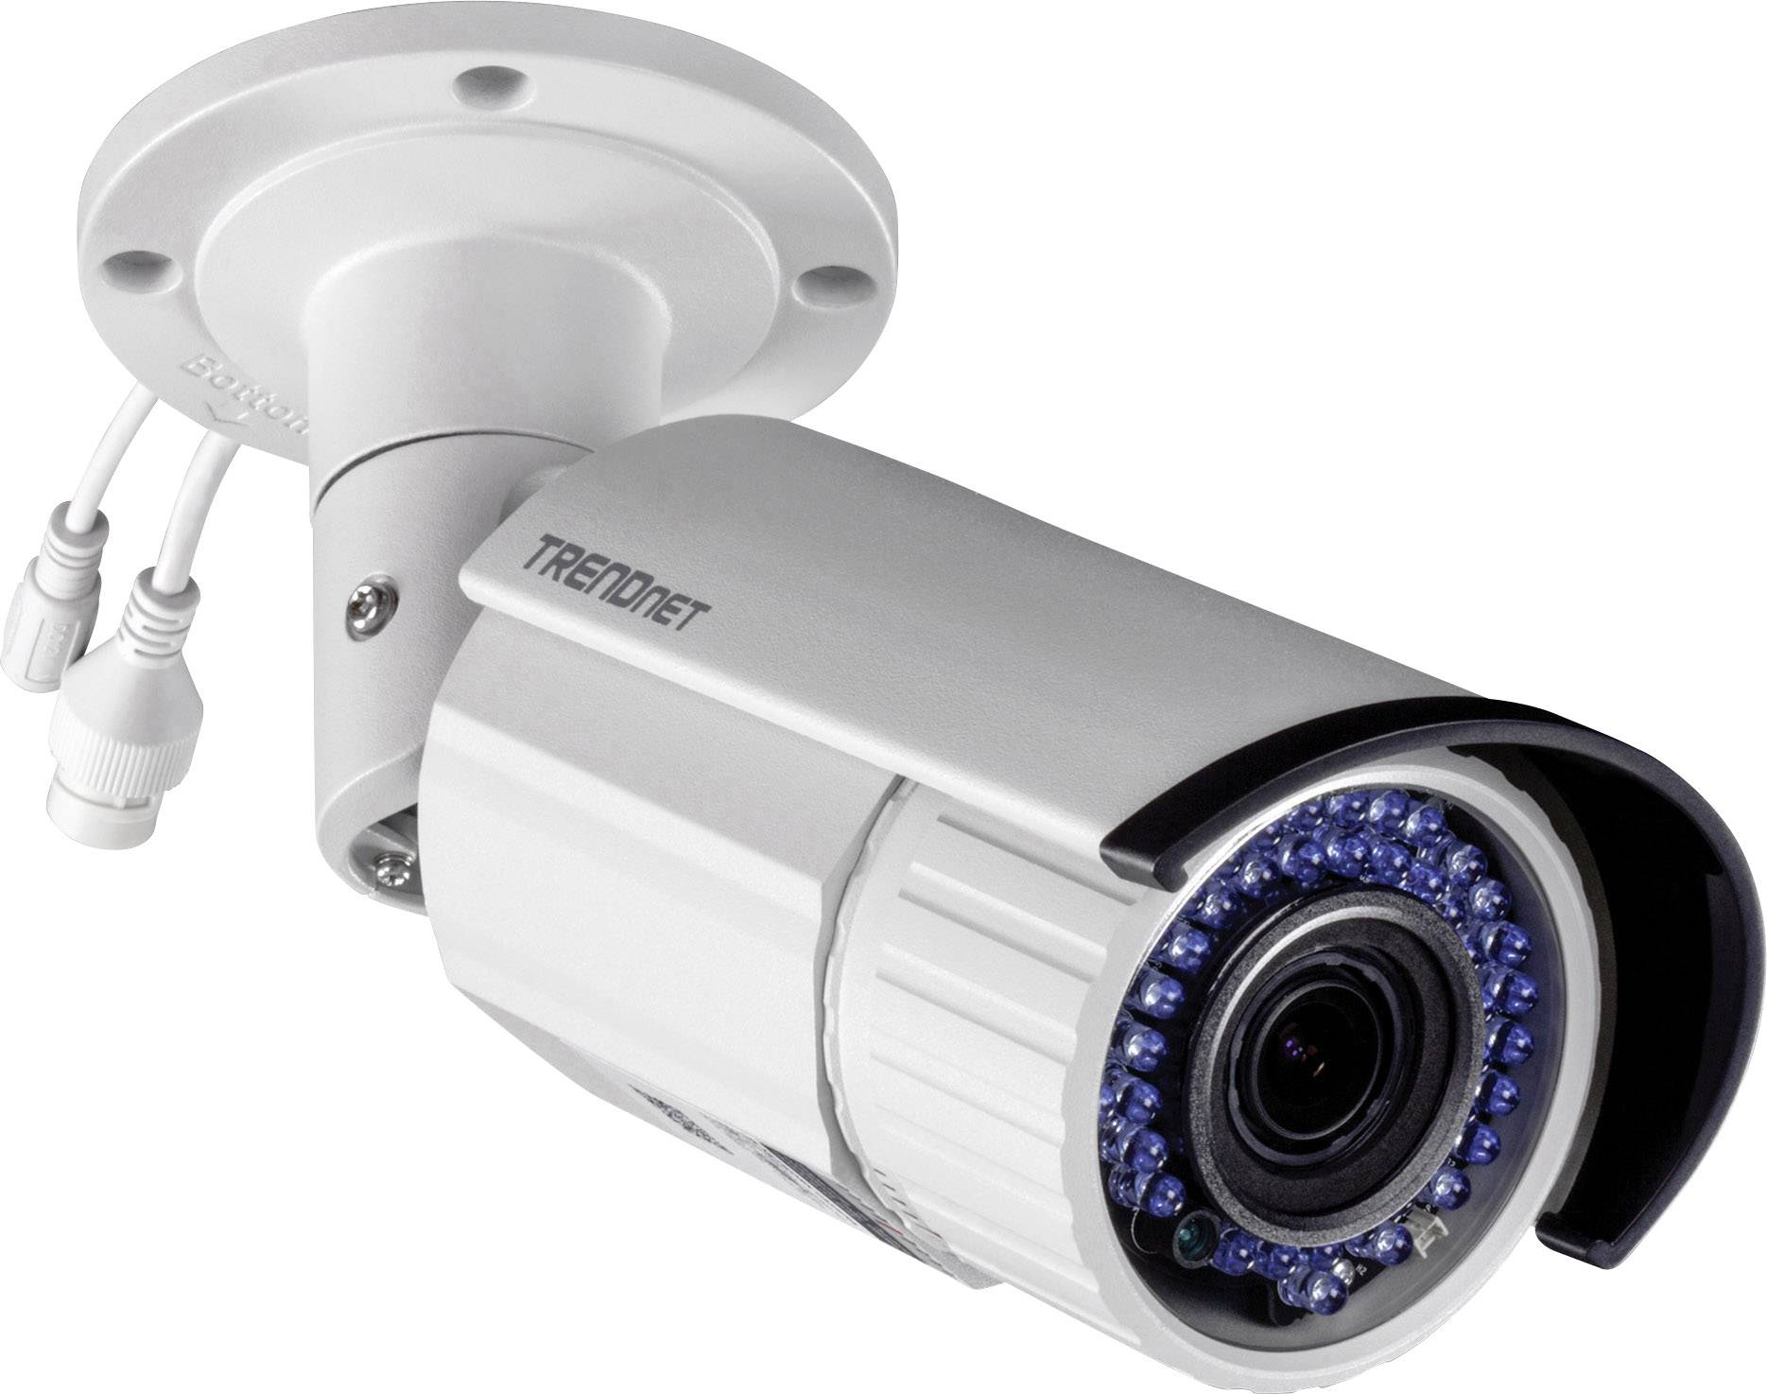

Comparison: Camera alternatives
RadSee:See Your Handwriting Through Walls Using FMCW Radar- Leonardo Rufini

Slide 7
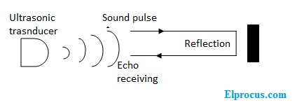
Comparison: UItrasound alternatives
RadSee:See Your Handwriting Through Walls Using FMCW Radar- Leonardo Rufini

Slide 8
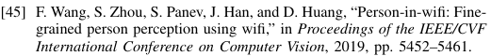
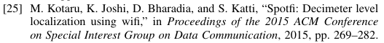
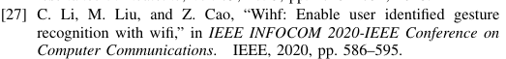
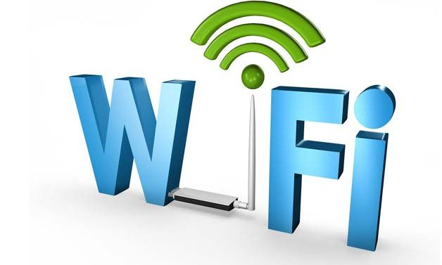
Comparison: Other alternatives
RadSee:See Your Handwriting Through Walls Using FMCW Radar- Leonardo Rufini

Slide 9
Challenges
RadSee:See Your Handwriting Through Walls Using FMCW Radar- Leonardo Rufini

Slide 10
Challenges
In the following slides I am going to introduce the main challenges that RadSee had to face in order to correctly detect handwriting through walls.
This challenges lead the researchers to implement the correct hardware step by step basing their conclusion also on the previous experiments.
RadSee:See Your Handwriting Through Walls Using FMCW Radar- Leonardo Rufini

Slide 11
1st Challenges: Wall
Detection through a wall significantly limits the viable sensing techniques for this task (no cam (light condition), no ultrasound (radar problem through wall), Radio frequency the same cause they use high frequency);
RadSee:See Your Handwriting Through Walls Using FMCW Radar- Leonardo Rufini

Slide 12
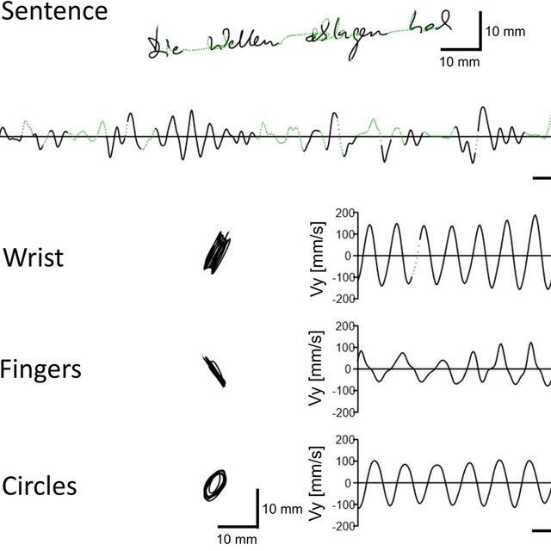
2nd Challenge: Precision
Millimeter level precision is need to track hand movements: high frequency mmWave are capable of capturing small movements, but can't pass through walls.
RadSee:See Your Handwriting Through Walls Using FMCW Radar- Leonardo Rufini

Slide 13
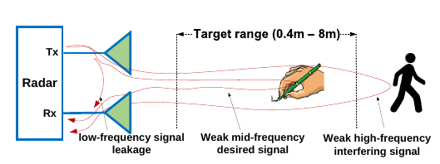
3rd Challenge: Interference
Interference resilience: handwriting detection could suffer from interference produced by other moving objects in the same room.
RadSee:See Your Handwriting Through Walls Using FMCW Radar- Leonardo Rufini

Slide 14
Hardware
How does RadSee addresses this challenges?
RadSee:See Your Handwriting Through Walls Using FMCW Radar- Leonardo Rufini

Slide 15
1st Challenge: patch antennas
RadSee implements 2 optimized patch antennas which allows the device to have 36dBi gain. This high gain allows RadSee to penetrate walls easily. RadSee will use a 6GHz FMCW wave module.
RadSee:See Your Handwriting Through Walls Using FMCW Radar- Leonardo Rufini

Slide 16
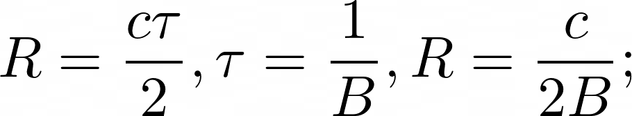
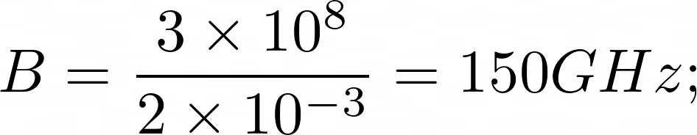
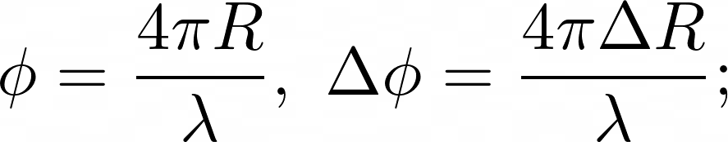
2nd Challenge: phase demodulation
This is all about math:
Using range resolution we would have: where c is the speed of light and B is the bandwidth of the antennas. To achieve range resolution of 1mm it requires: which is infeasible in practice;
However, the phase of demodulated FMCW signals is much more sensitive on movement of objects: where lambda is the wavelength of the signal. Therefore, RadSee uses the phase of the demodulated FMCW signals.
RadSee:See Your Handwriting Through Walls Using FMCW Radar- Leonardo Rufini

Slide 17
3rd Challenge: Fast Fourier Transform
RadSee is able to distinguish only the handwriting movement thanks to FMCW signal modulation and high-directional patch antennas. Let’s see how the analysis is performed:
Thanks to highly directional patch antennas RadSee is able to ignore signals from other direction except a small zone to which he is pointing to;
RadSee:See Your Handwriting Through Walls Using FMCW Radar- Leonardo Rufini

Slide 18
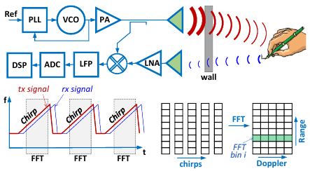
Fast Fourier Transform
The signal arrives to the target and is reflected like a radar device;
FMCW signal is transformed through a Fourier transform function which divides the signal in bin, small intervals which corresponds to different distances. This is possible thanks to the FFT that transport the signal from the time domain to the frequency domain. In this way RadSee can analyze only the bin corresponding to the hand distance. A bin containing a spike correspond to an object rilevation;
RadSee:See Your Handwriting Through Walls Using FMCW Radar- Leonardo Rufini

Slide 19
Attack Models
I will now show different scenarios in which we could perform an attack using RadSee.
RadSee:See Your Handwriting Through Walls Using FMCW Radar- Leonardo Rufini

Slide 20
Attack Model: Victim
To perform an attack on a victim, the following constraints must be satisfied:
The victim is writing confidential informations on a paper or an electronic device (Ipad ecc.), no keyboard typing allowed;
The victim is writing english letters and Arabic numbers;
The victim is facing towards the attacker;
RadSee:See Your Handwriting Through Walls Using FMCW Radar- Leonardo Rufini

Slide 21
Attack Model: Attacker
To perform the attack correctly, also the attacker must satisfy some constraint:
The attacker has physical access to space behind the wall;
The attacker has an approximate knowledge on victims position inside the room (can be estimated using radar signals);
There are no RF-shielding materials inside the wall between the victim and the attacker;
RadSee:See Your Handwriting Through Walls Using FMCW Radar- Leonardo Rufini

Slide 22
Bonus Challenge: BiLSTM
The challenge are all addressed and we have our handwriting signal, but the job is not completed jet.
We are missing the letter and wording recognition part of the problem.
Also if the detection goes well, we still have 62 possible characters (26 letters + 26 capital letters + 10 numbers).
RadSee uses a BiLSTM (Bidirectional Long Short-Term Memory) to classify handwriting characters.
What are BiLSTM and how do they work ?
RadSee:See Your Handwriting Through Walls Using FMCW Radar- Leonardo Rufini

Slide 23
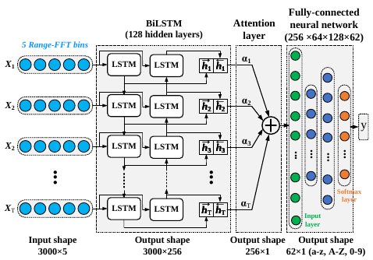
BiLSTM
LSTM are a kind of neural network designed to analyze data streams (words, texts or phase sequences signals).
LSTM has a memory that allows them to remember important past informations and forget the useless one. This is really important when data has a time sequenced structure.
The BiLSTM has 2 LSTM, one of them read the sequence forward from start to end, and the other one reads the same sequence in the reverse order.
RadSee:See Your Handwriting Through Walls Using FMCW Radar- Leonardo Rufini

Slide 24
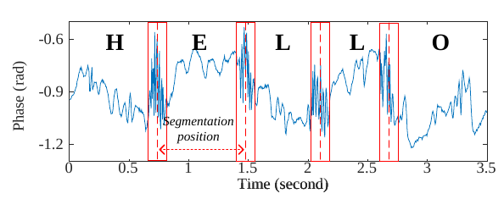
BiLSTM
Since the writing activity consists in a continuous phase movement for the writing hand, in practice each letter generates a unique temporal phase pattern.
For instance, we will be more interested in detecting the turning points more then the horizontal strokes. For this reason RadSee is focused on the BiLSTM model to pay attention to those important parts.
RadSee:See Your Handwriting Through Walls Using FMCW Radar- Leonardo Rufini

Slide 25
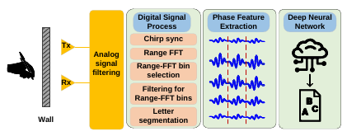
Data Processing
RadSee:See Your Handwriting Through Walls Using FMCW Radar- Leonardo Rufini

Slide 26
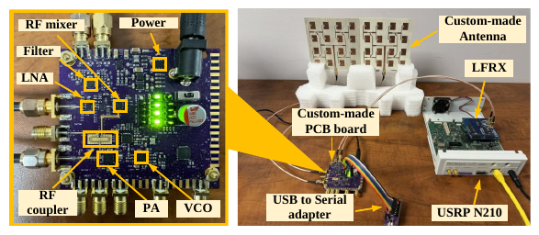
The device
RadSee:See Your Handwriting Through Walls Using FMCW Radar- Leonardo Rufini

Slide 27

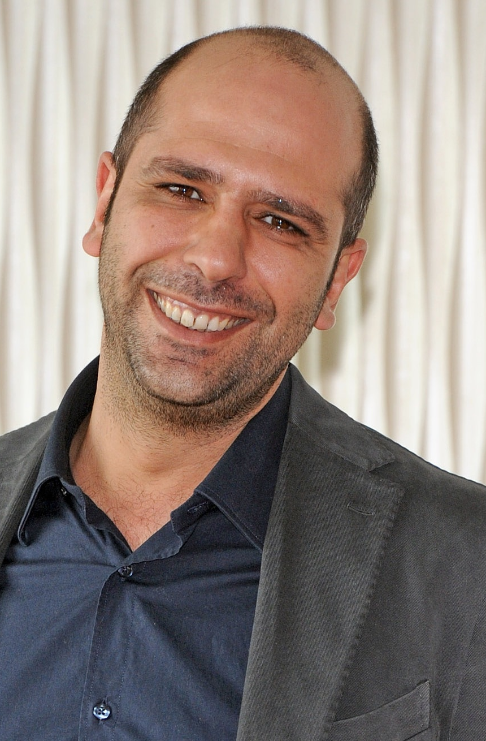
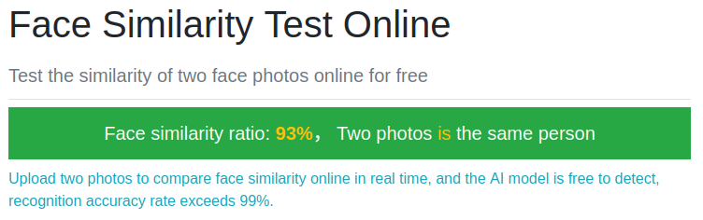
AI can fail!
RadSee:See Your Handwriting Through Walls Using FMCW Radar- Leonardo Rufini

Slide 28
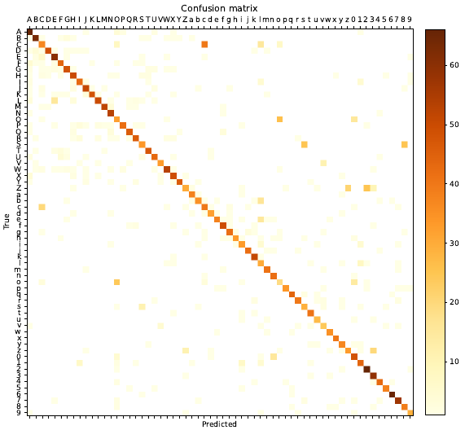
Results
RadSee achieves 75% letter recognition accuracy when victims write 62 random letters, and 87% word recognition accuracy when they write articles.
RadSee:See Your Handwriting Through Walls Using FMCW Radar- Leonardo Rufini

Slide 29
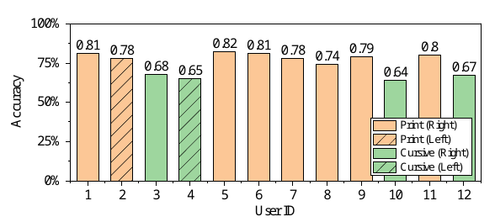
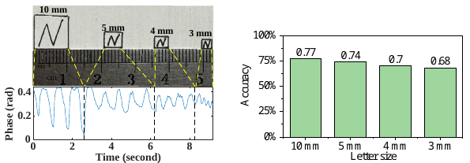
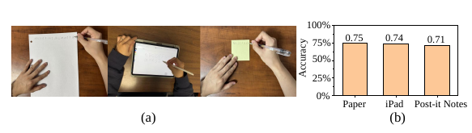
Results
RadSee:See Your Handwriting Through Walls Using FMCW Radar- Leonardo Rufini

Slide 30
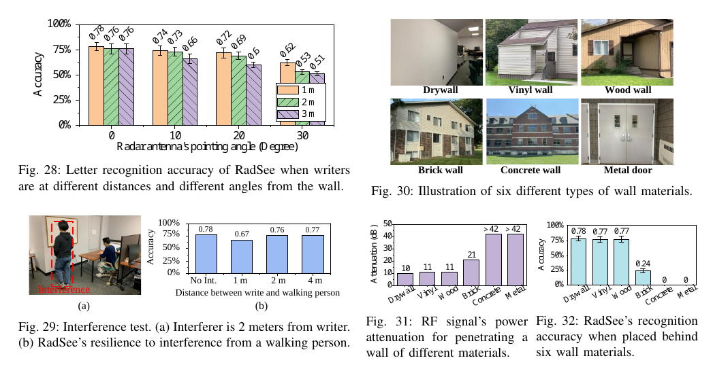
Results
RadSee:See Your Handwriting Through Walls Using FMCW Radar- Leonardo Rufini

Slide 31
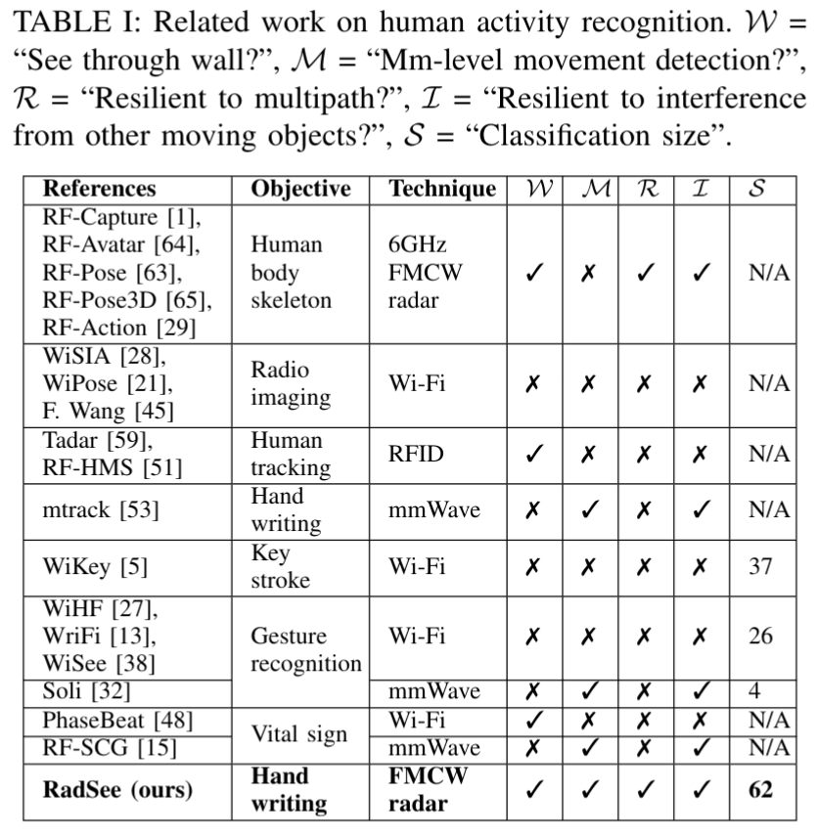
Comparison table
This is a comparison table that shows the features of RadSee with respect to other HAR (Human Activity Recognition) similar systems.
RadSee:See Your Handwriting Through Walls Using FMCW Radar- Leonardo Rufini

Slide 32
Thank you for the attention!

